Slide 1
WELCOME TO AWS DEVOPS PROJECT OVERVIEW

Slide 2

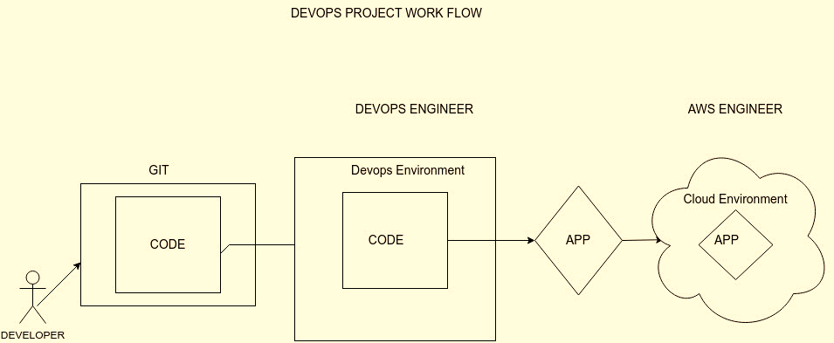
DEVOPS PROJECT WORK FLOW

Slide 3
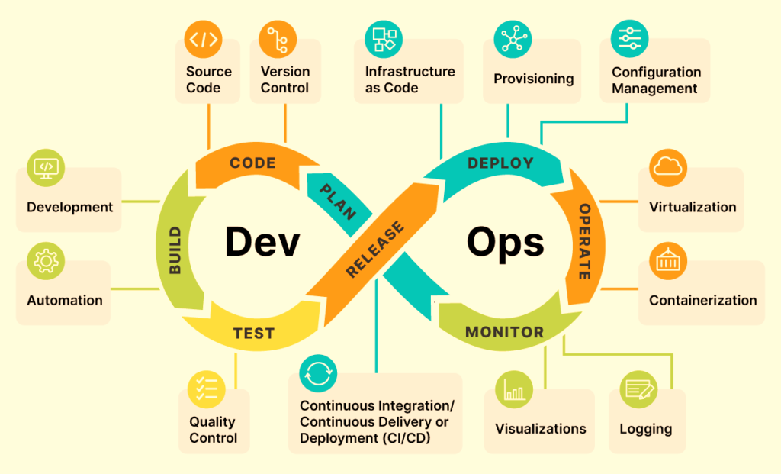
DEVOPS ENVIRONMENT

Slide 4
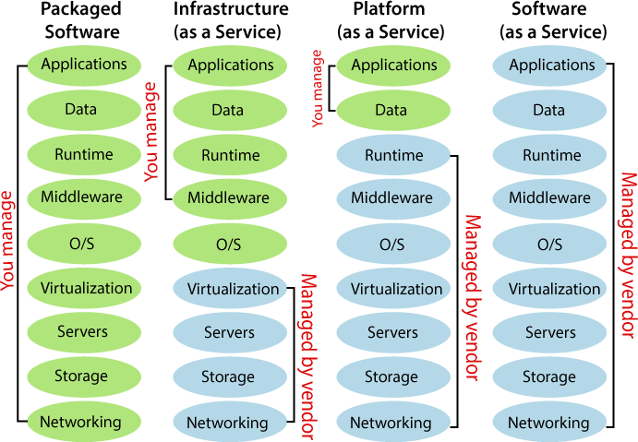
Cloud Services

Slide 5
AWS
Module 1 - Introduction To Cloud Computing & AWS Preview
Cloud Computing Introduction
Cloud Service and Deployment Models What Is AWS?
AWS Service Domains Virtualization In AWS Aws account Creation.
Module 2 – Elastic compute cloud
Introduction To EC2 Pre-EC2
Instance Tenancy, Reserved and Spot Instances EC2 Instance Types
Launching An Instance What Is An AMI?
Creating And Copying An AMI.
Instance Termination
Module-3- Elastic block storage
Introduction To EBS EBS Concepts
EBS Snapshots
Creating And Mounting an EBS Volume
AWS EBS Multi-Attach
Module-4- Elastic File storage
Introduction To EFS
Creating And Mounting An EFS
Pricing And Design Patterns

Slide 6
Module-5- Elastic Load Balancer
Introduction To ELB
Load Balancer Architecture
Load Balancers setup
Creating Classic , Application and Network Load Balancer
Cross-Zone Load Balancing
Module-7- Route53
Pre-Route 53
Hosting Our Website and DNS Literature Routing Policy
Godaddy: Getting Free Domain Name Use Route 53 To Route Traffic To ELB AWS ELB
Weighted Routing
Module-6- Auto scaling group
Introduction To Auto Scaling
Lifecycle Of Auto Scaling
Components Of Auto Scaling
Scaling Policy
ELB And AS Integration Creating Auto Scaling Groups
Integrating Auto Scaling Group To The ALB

Slide 7
Module-8-Virtual Private Cloud
Amazon VPC Overview and IP Address
CIDR Notations
Creation of VPC
Components Of VPC
Create Internet Gateways and NAT Gateways Types Of VPC And Subnet Overview Security In VPC
Creation of NAT Gateway VPC Architecture
VPC Peering and VPC Endpoints
Module-9- Simple Storage Service (S3)
Pre-S3: Online Cloud Storage Introduction
Understanding Examples and Creating S3 Bucket Storage Hierarchy
Objects
Lifecycle Management and Storage Classes Storage Class Analysis
Cross-Region Replication
Data Encryption and Server Access Logging Website Hosting
S3 Access Point and Connecting Using VPC Endpoint

Slide 8
Module-10- Relational Data Service
Introduction To RDS Features Of Amazon
RDS Read Replica
Reserved DB Instances, Pricing and Designs
Introduction To DynamoDB
Core Components of DynamoDB
Primary Key
Secondary Indexes DynamoDB Streams
DynamoDB Pricing and Designs
DynamoDB Table and Operations
Module-11- Identity Access Management
Introduction To IAM Amazon Resource Names IAM Features
Multi-Factor Authentication
IAM Users and Groups IAM Policies
IAM Permissions IAM Roles
Module-12- CloudWatch
Introduction To CloudWatch
CloudWatch Metrics and Namespaces
CloudWatch Alarms
CloudWatch Logs
CloudWatch Architecture

Slide 9
Module-13- Simple Notification Service
Introduction of SNS
Create A SNS
Module-14- Simple Email Service
Introduction of SES
Create A SES
Module-15- Simple Queue Service
Introduction of SQS
Create A SQS
Module-16-Project

Slide 10
Devops
Module-1-Linux
Creating the files
Provide permissions
Umask
Connect local machine to virtual machine
Module-3- Version Control With Git
What Is Version Control System?
Types Of Version Control System
Introduction To Git
Git Lifecycle And How Git Works?
Common Git Commands
Merging Branches
Merge Conflicts Git Workflow
Forking In GitHub
Git clone
Git stash
Git Hub connection loss
Module-2 Introduction to Devops
Software Development Lifecycle Waterfall Models
Agile Model
Introduction to DevOps Tool

Slide 11
Module-4-Maven Why Maven? What Is Maven? What Does Maven Do? Building POM Files Maven Repositories Maven Installation
Module-5- CI/CD With Jenkins
Introduction To Continuous Integration
What Is Jenkins?
Installing Jenkins On AWS Jenkins Installation
Jenkins Architecture Managing Nodes On Jenkins
Jenkins Master Node Connection
Jenkins Integration With DevOps Tools
Understanding CI/CD Pipelines
Creating A CI/CD Pipeline
Jenkins Upgration
Module 6 – Sonarqube
What Is Software Testing?
What Is SonarQube?
Features Of SonarQube
SonarQube Installation
Code Analysis

Slide 12
Why Docker?
What Is Docker?
Docker Installation Docker Lifecycle
Common Docker Operations
Creating A Docker Hub Account
Container Pushing To Docker Hub
Introduction To Dockerfile
Docker Storage
Linking Docker Containers
Module-7- DOCKER
Introduction To Docker Compose
What Are YAML Files?
Writing A Docker Compose File
Deploying WordPress Using Docker Compose Creating A Docker Swarm Cluster
Creating A Service
Docker Networks
Implementing the Docker Network

Slide 13

Module 8 - Kubernetes
Introduction To Kubernetes
Docker Swarm Vs Kubernetes
Kubernetes Installation
EKS Set up
Working Of Kubernetes
Kubernetes cluster creation
Creation of Worker nodes with group
Creating An Ingress
Kubernetes Pod
Kubernetes Job
Kubernetes CronJob
Kubernetes Configmaps
Deploy Application in Worker Nodes
Module 9 – Ansible
What Is Ansible Why Ansible?
How Does Ansible Work? Ansible Architecture
Install Ansible On AWS
Creating Ansible Playbooks Ansible Roles
Using Roles In Playbook
Module 10 – Terraform
What Is Infrastructure As Code (IaC)?
Infrastructure As Code Vs Configuration Management Introduction To Terraform
Installing Terraform For AWS Basic Terraform Operations Terraform Code Basics
Deploying An End To End Architecture Using Terraform

Slide 14
Module -11- TOMCAT
What is Tomcat
How to install Tomcat in windows
How to install Tomcat in Linux / AWS
How to deploy code in Tomcat
Deploying code by using Jenkins
Module-12- ARGOCD
What is Argo CD?
Introduction to Argo CD
Overview of Continuous Delivery
Installation and Setup
CD miniproject with argocd and k8s
Ultimate CI-CD with Git,Jenkins , Maven ,Sonar, Docker , Kubernetes (EKS) & ARGOCD
Module – 13- Monitoring Tools
Nagios
Prometheus
Grafana
Module -14 - Project

Slide 15



Thank You
Any Questions
Contact Number
9390190337

